Slide 1
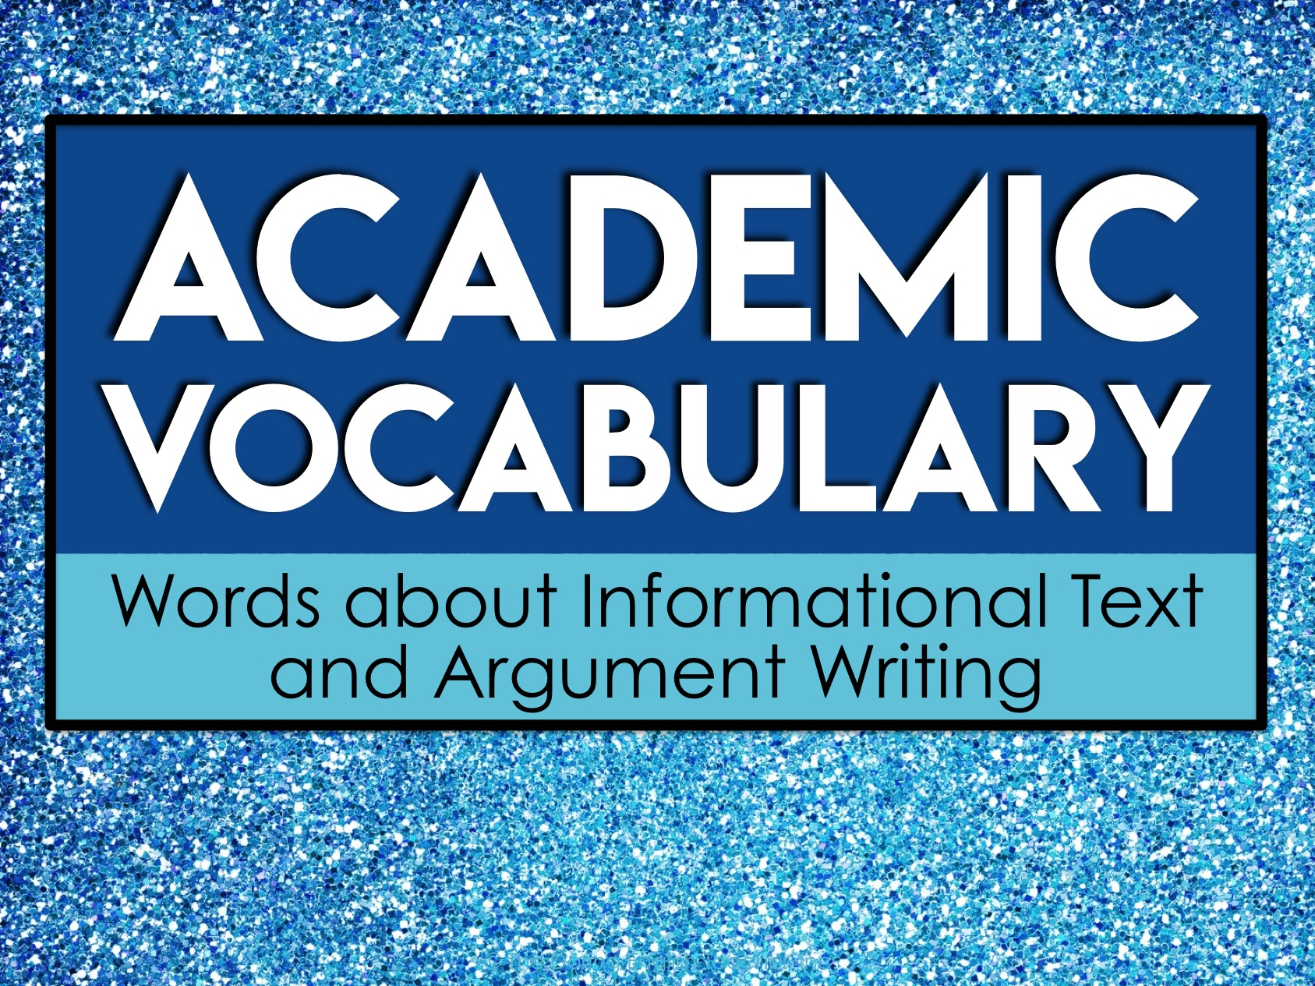
Academic
Vocabulary
Words about Informational Text
and Argument Writing

Slide 2
About Academic Vocabulary
Academic vocabulary refers to words that you will likely encounter in an academic setting.
Academic vocabulary shows up in text books, standardized tests, and in instructions for school assignments.
The more academic vocabulary you know, the more likely you are to be successful in school!

Slide 3
Focus on Five at a Time
We will learn 25 new academic vocabulary terms during this unit.
However, we will only focus on five words at a time.
Each week we will have five new words to learn.

Slide 4
Our Week in Academic Vocabulary
Monday: Introduce the words.
Tuesday: Draw it out.
Wednesday: Word Web Wednesday!
Thursday: Reflect about the words.
Friday: Quiz time!
End of the unit: We will review ALL 25 of the academic words you’ve learned.

Slide 5
Monday
On Mondays, we will take a quick pretest on five new vocabulary words.
Then, we will go over each word.
You’ll write the words and their definitions on your weekly handout.

Slide 6
Tuesday
On Tuesdays, we will take a few minutes to review the words.
During this time, you’ll draw a quick visual representation for each word.
The drawings do not need to be perfect. Anything that helps you associate the word to the definition will help you!

Slide 7
Wednesday
On Wednesdays, we will take a few minutes to review the words.
During this time, you’ll create a word web for each word.
A word web is a graphic representation containing words. You’ll write words that have similar meanings and words that are associated with the vocabulary term on your paper.

Slide 8
Word Web Example
language
list
vocabulary
terms
words

Slide 9
Thursday
On Thursdays, we will take a few minutes to review the words.
During this time, you’ll look over all of the work from the week and write a brief reflection about what you learned.
Your reflection should be at least three sentences long and contain some of the vocabulary words.

Slide 10
Reflect/Journal
Your vocabulary journal/reflection should be at least three sentences long. You can use these questions to help get you started.
What did you learn about the words?
What word did you not know prior to this week?
How do these words relate to one another?
How will knowing these words help you succeed in an academic setting?

Slide 11
Friday
On Fridays, we will take a quick test on five vocabulary words from the week.
After the test, you’ll record your score and write down the words you still need to study.
As we continue with new words, make sure you go back and revisit the words you still need to learn.

Slide 12
Academic
Vocabulary
Words about Informational Text
and Argument Writing

Slide 13
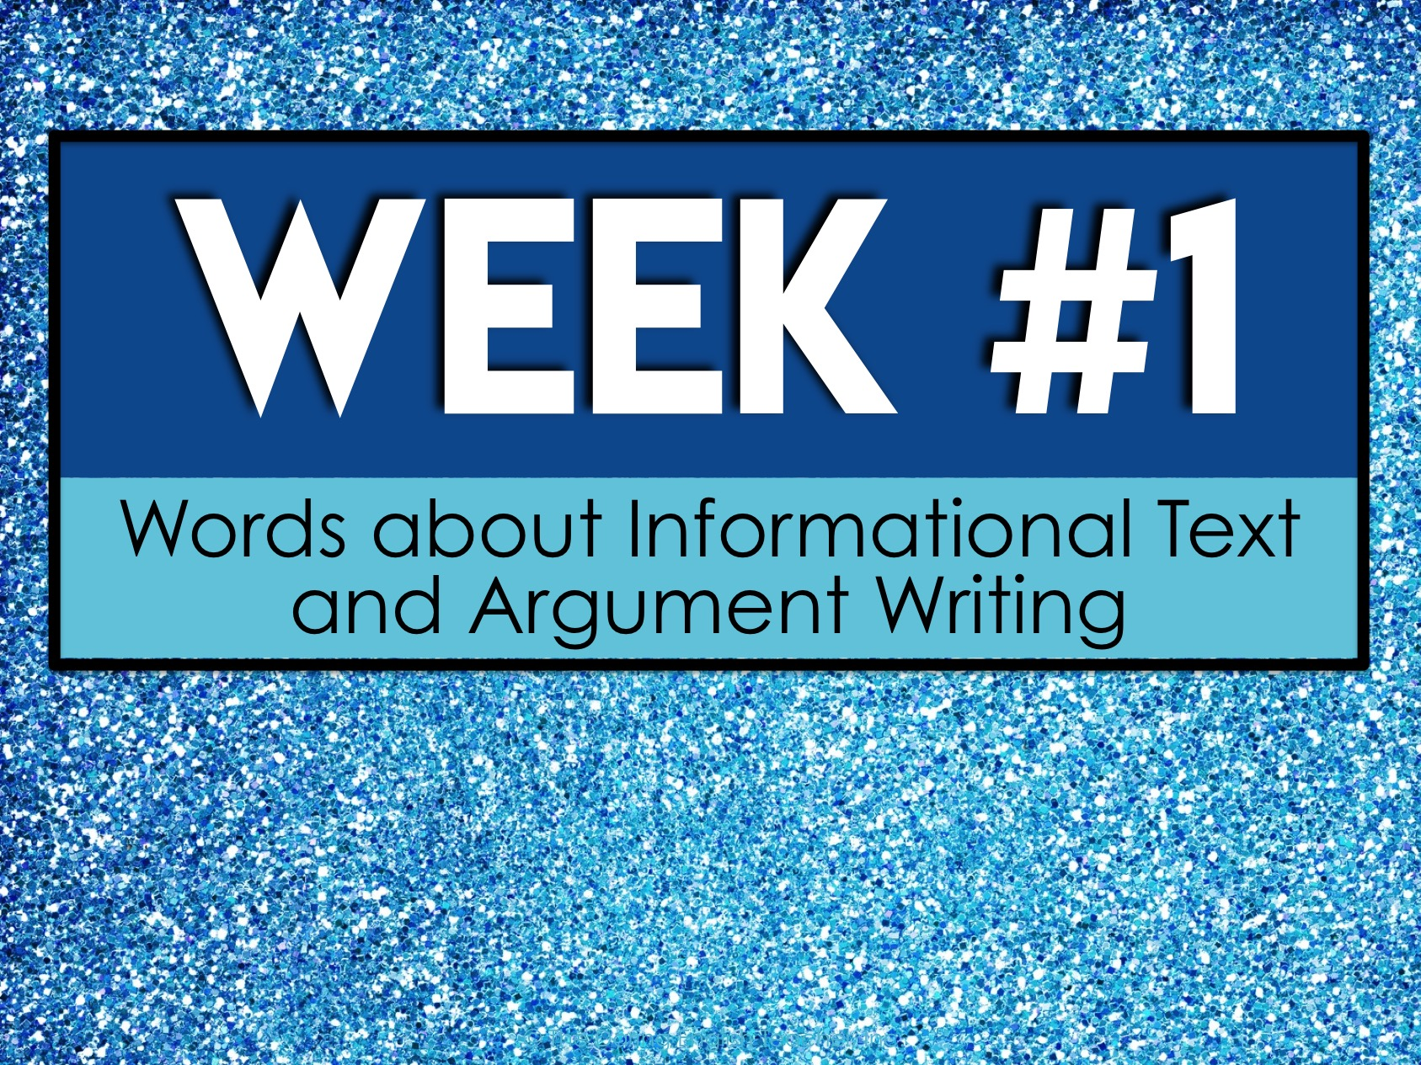
Week #1
Words about Informational Text
and Argument Writing

Slide 14
Week #1 Words
Annotation
Argument
Audience
Central idea
Citation

Slide 15
Week #1 Pretest
DIRECTIONS: In your own words, try your best to define each term.
Annotation
Argument
Audience
Central idea
Citation

Slide 16
Annotation
notes added to a text while participating in active reading

Slide 17
Argument
a statement, reason, or fact for or against a point

Slide 18
Audience
the persons reached by a book, radio or television broadcast, etc.; public

Slide 19
Central idea
the main idea of a writing; the point the author wants you to remember most

Slide 20
Citation
a quotation from or reference to a book, paper, or author, especially in a scholarly work

Slide 21
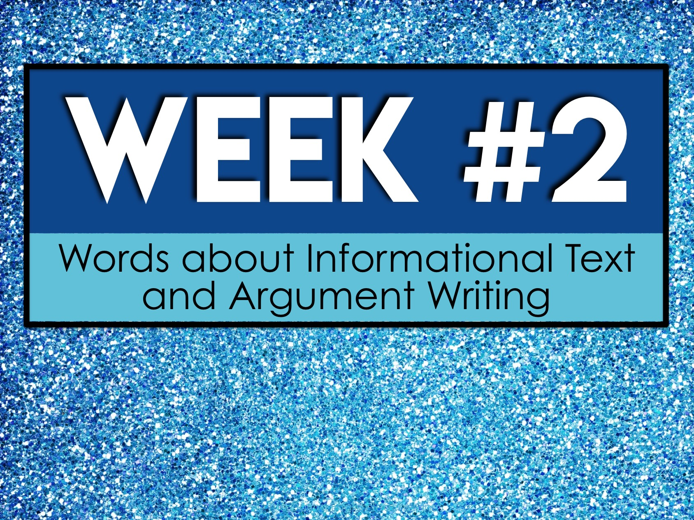
Week #2
Words about Informational Text
and Argument Writing

Slide 22
Week #2 Words
Claim
Connotative
Counterclaim
Credibility
Denotative

Slide 23
Week #2 Pretest
DIRECTIONS: In your own words, try your best to define each term.
Claim
Connotative
Counterclaim
Credibility
Denotative

Slide 24
Claim
an assertion of something as a fact

Slide 25
Connotative
signifying or suggestive of an associative or secondary meaning in addition to the primary meaning

Slide 26
Counterclaim
a claim made to rebut a previous claim

Slide 27
Credibility
the quality of being trusted and believed in

Slide 28
Denotative
the explicit or direct meaning or set of meanings of a word or expression as distinguished from the ideas or meanings associated with it or suggested by it

Slide 29

Week #3
Words about Informational Text
and Argument Writing

Slide 30
Week #3 Words
Diction
Ethos
Explicit
Fallacious reasoning
Fallacy

Slide 31
Week #3 Pretest
DIRECTIONS: In your own words, try your best to define each term.
Diction
Ethos
Explicit
Fallacious reasoning
Fallacy

Slide 32
Diction
the choice and use of words and phrases in speech or writing

Slide 33
Ethos
an appeal to ethics and credibility

Slide 34
Explicit
stated clearly and in detail, leaving no room for confusion or doubt

Slide 35
Fallacious reasoning
faulty or mistaken logic

Slide 36
Fallacy
a mistaken belief, especially one based on unsound argument

Slide 37
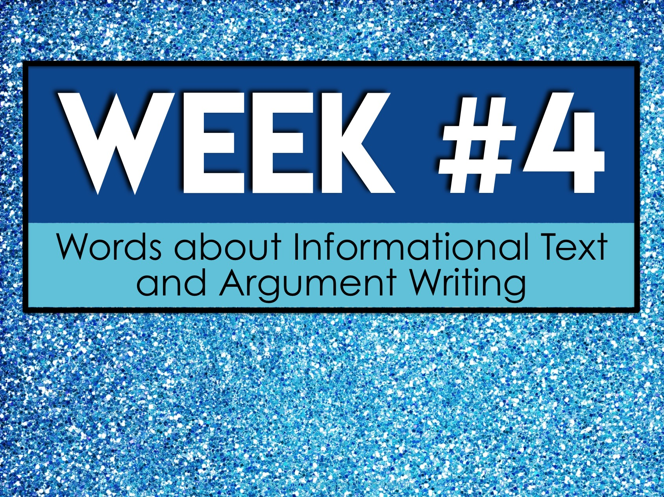
Week #4
Words about Informational Text
and Argument Writing

Slide 38
Week #4 Words
Inference
Logos
Pathos
Point-of-view
Purpose

Slide 39
Week #4 Pretest
DIRECTIONS: In your own words, try your best to define each term.
Inference
Logos
Pathos
Point-of-view
Purpose

Slide 40
Inference
a conclusion reached on the basis of evidence and reasoning

Slide 41
Logos
an appeal to logic and reason

Slide 42
Pathos
an appeal to emotion

Slide 43
Point-of-view
the author’s perspective on the topic

Slide 44
Purpose
the author’s reason for writing the piece

Slide 45
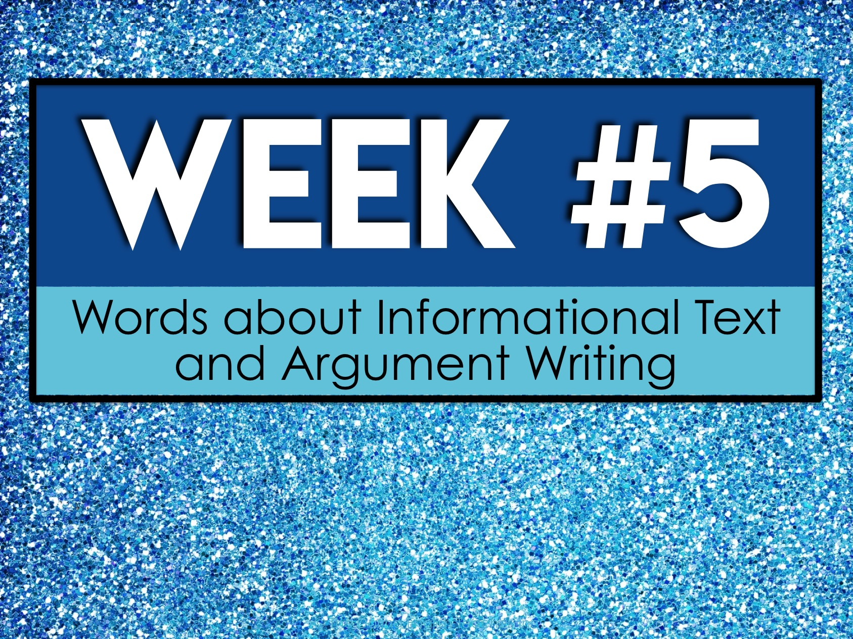
Week #5
Words about Informational Text
and Argument Writing

Slide 46
Week #5 Words
Relevant
Rhetoric
Sufficient
Thesis
Tone

Slide 47
Week #5 Pretest
DIRECTIONS: In your own words, try your best to define each term.
Relevant
Rhetoric
Sufficient
Thesis
Tone

Slide 48
Relevant
closely connected or appropriate to the matter at hand

Slide 49
Rhetoric
the art of effective or persuasive speaking or writing, especially the use of figures of speech and other compositional techniques

Slide 50
Sufficient
enough; adequate

Slide 51
Thesis
a subject for a composition or essay

Slide 52
Tone
the author’s attitude toward the subject

